Slide 1

F# in Social Gaming
Yan Cui (@theburningmonk)

Slide 2

Who is Gamesys?
Founded in 2001
#1 in the UK
Handle $5 Billion in turnover annually
First company to launch real money gaming on Facebook
Employ 1,000 globally

Slide 3







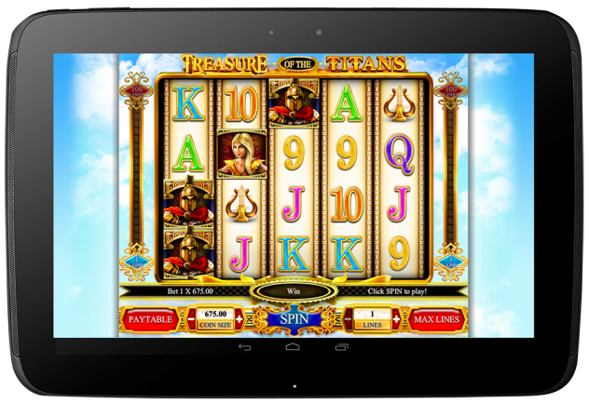



Slide 4
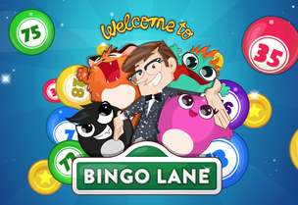

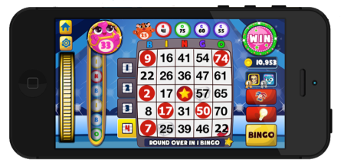



Slide 5


Slide 6
What is F#?
Functional-first
ML family of languages
1st class citizen on the .Net platform
also supported by Mono

Slide 7
What is F#?
Records
Discriminated Unions
MailboxProcessor (aka Agents)
Computation Expressions (aka Workflows)
Type Providers
Quotations
Units of Measure

Slide 8
Why F#?
Time to Market
Efficiency
Correctness
Complexity

Slide 9

Case Study #1
Slots Engine
Written in F#
The ‘brain’
Enforces game rules and maths model

Slide 10
Special Symbol
Collectables
Avg Wager Size
Wager Size
Web Server call

Slide 11
Winning at Slots
Line Win
X number of matching symbols on adjacent columns
Positions have to be a ‘line’
Wild symbols substitute for other symbols
Scatter Win
X number of matching symbols anywhere
Triggers bonus game

Slide 12

What’s the player’s new avg wager?
What symbols should land?
What lines did the player bet on?
How much did the player wager?
Did the player win anything?
Any special symbol wins?
Should the player receive collectables?

Slide 13
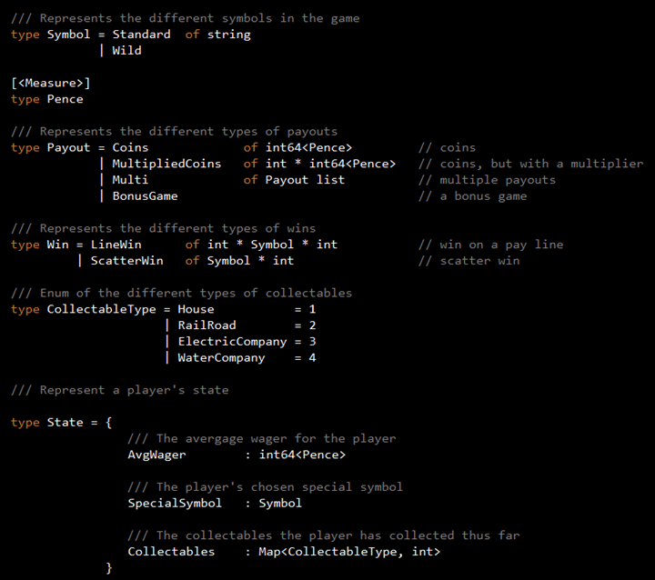

Slide 14
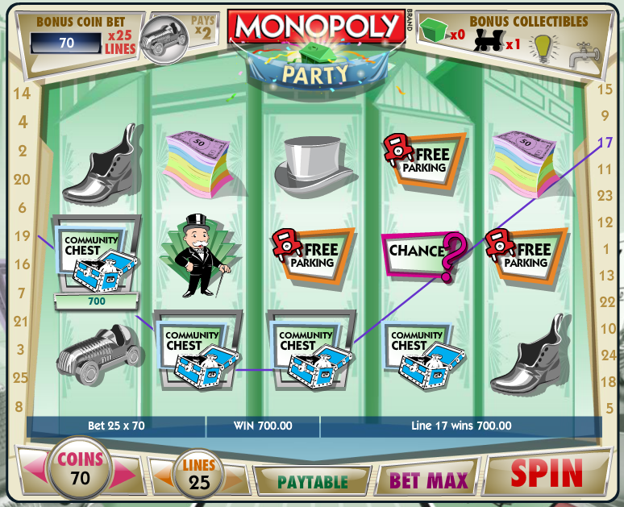
New avg wager
Got a Collectable!
A pay line win!

Slide 15
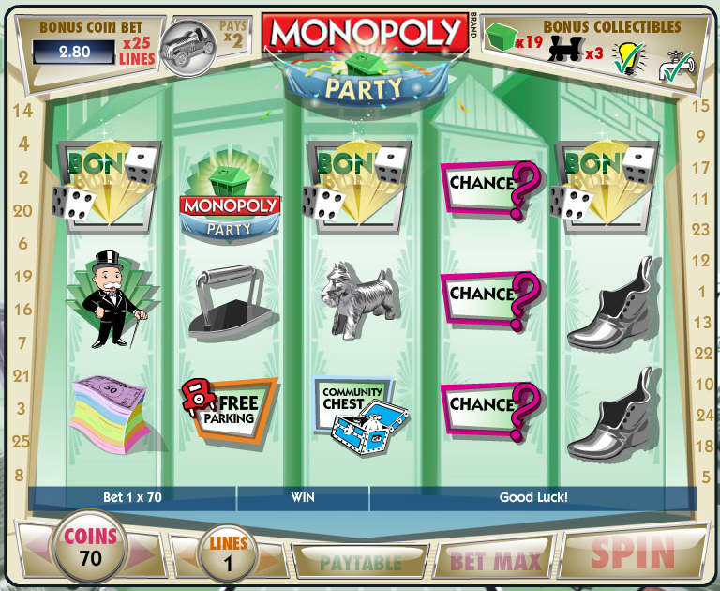
Bonus Game!
Betting small reduces avg wager!

Slide 16

Use collectables

Slide 17
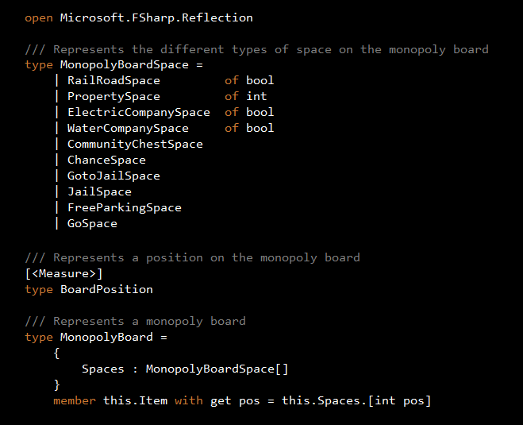

Slide 18
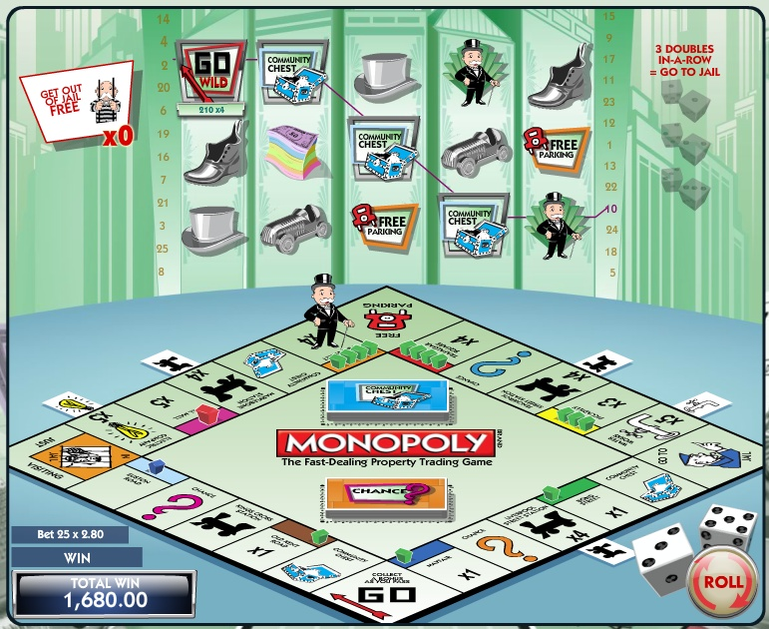
Collected in the bonus game.
Gives player extra ‘lives’.
And a pay line win!
Houses = multiplier on wins
GAME OVER
Coin size brought over from main game

Slide 19
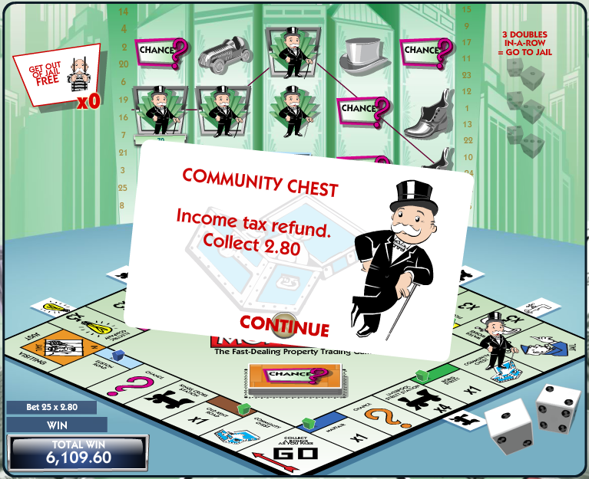

Slide 20
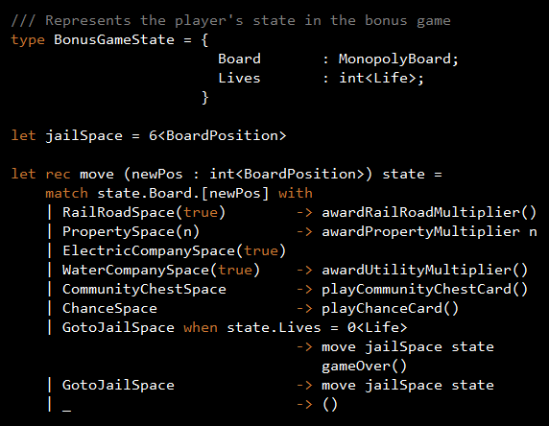

Slide 21


Slide 22
Why F#?
Time to Market
Efficiency
Correctness
Complexity

Slide 23
Why F#?
Record and Discriminated Unions
Lightweight syntax for creating types and hierarchies
Illegal states cannot be represented
Immutable by default
Pattern matching
Clear and concise way to handle all branch conditions
Unit of Measure
Prevents a whole class of errors related to misuse of units
Notes:
TODO: mention algebraic data types in relation to DU

Slide 24
Case Study #2
Stateful Server
Actor-based architecture

Slide 25


Travel, Collect, Craft!

Slide 26

Trap Monsters

Slide 27
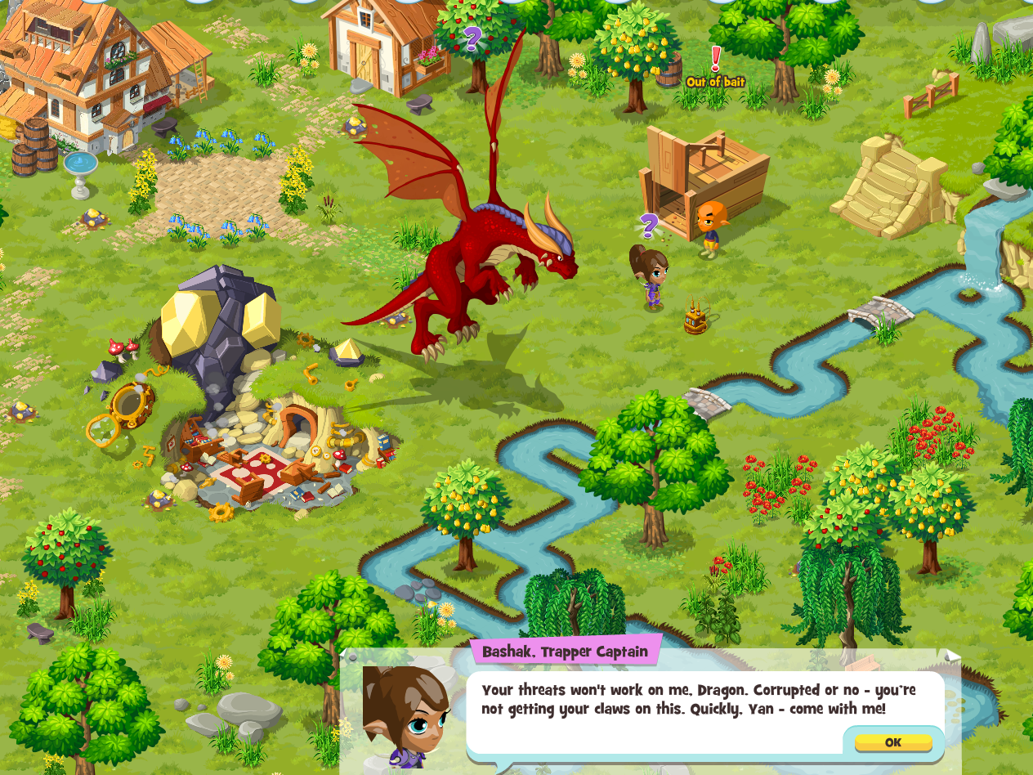

Slide 28







Stateful Server
EC2
Elastic Load Balancer
CloudFront
Server A
Server B
...
Auto scaling Group
S3

Slide 29
Stateful Server
Need to ensure Server affinity
All calls need to be routed to the affined server
Need to balance load
Session lengths vary greatly
Some players are more active than others
Need to avoid hot spots
Need to avoid players hogging a server
Need to be able to scale down!

Slide 30
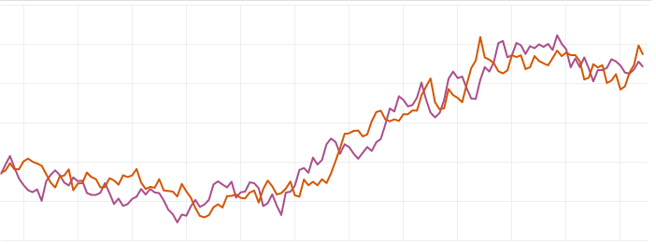
Stateful Server
Persist player state after short inactivity
Move player to another server after persistence

Slide 31
Why Stateful Server?
500% efficiency increase
60% reduction in avg latency
Fewer game servers
No CouchBase cluster
Huge saving on cost

Slide 32
The Actor Model
An actor is the fundamental unit of computation which embodies the 3 things
Processing
Storage
Communication
that are essential to computation.
Carl Hewitt*
* http://bit.ly/HoNHbG

Slide 33
The Actor Model
Everything is an actor
An actor has a mailbox
When an actor receives a message it can:
Create new actors
Send messages to actors it has addresses for
Designate how to handle the next message it receives

Slide 34
Stateful Server
Gatekeeper
Manages the local list of active workers
Spawns new workers
Worker
Manages the states for a player
Optimistic locking
Persist state after period of inactivity

Slide 35
Stateful Server
Asynchronous
Request Handlers
Player A
Gatekeeper
S3
Worker C
Player B
Worker B
Game Server

Slide 36
Stateful Server
Asynchronous
Request Handlers
Worker A
Player A
ok
Gatekeeper
S3
Worker C
Player B
Worker B
Game Server

Slide 37
Stateful Server
Asynchronous
Request Handlers
Worker A
Player A
Gatekeeper
S3
Worker C
Player B
Worker B
Game Server

Slide 38
Stateful Server
Asynchronous
Request Handlers
Worker A
Player A
Gatekeeper
S3
Worker C
Player B
Game Server

Slide 39
Stateful Server
Asynchronous
Request Handlers
Worker A
Player A
Gatekeeper
S3
error
Worker C
Player B
Game Server

Slide 40
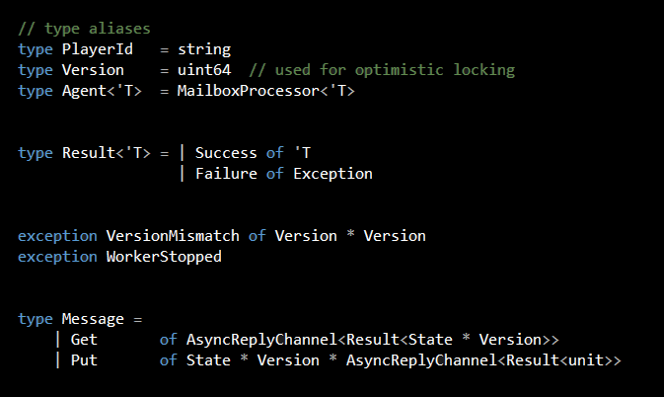

Slide 41
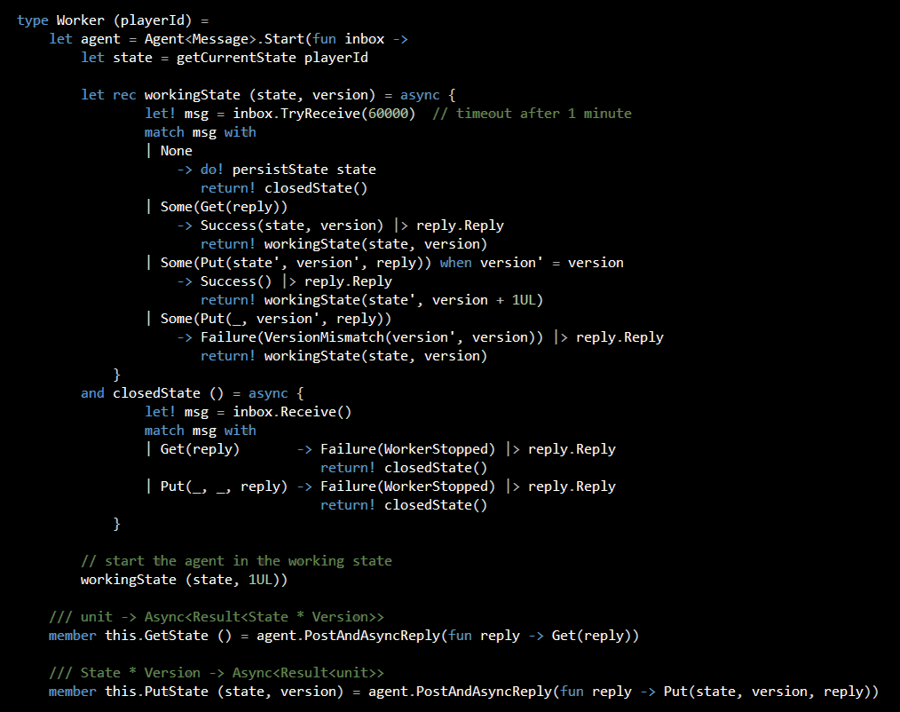
MailboxProcessor<Message>

Slide 42
Async<Message option>

Slide 43
switch state

Slide 46
Why F#?
Time to Market
Efficiency
Correctness
Complexity

Slide 47
Why F#?
Agents
No locks
Asynchronous message passing
Each actor is self-contained and easier to reason with
Pattern matching
Clear and concise way to handle all branch conditions
Notes:
The biggest advantage of programming with the Actor model, for me, is the fact that each actor is self-contained and implements an explicit protocol, hence making them very easy to reason with and often it’s possible to look at the code and know that there’s obviously no defect rather than no obvious defect, and that distinction is important.
The only operation with the inbox which requires synchronization (as far as I know) is with selective receive using inbox.Scan, otherwise, it’s inherently single-threaded inside the body of an agent (a property of the Actor model).

Slide 48
Why F#?
Async Workflows
Non-blocking IO
Convert synchronous code into asynchronous code with minimal code changes
Similar to C# 5’s async-await feature, but available in F# since 2007!

Slide 49
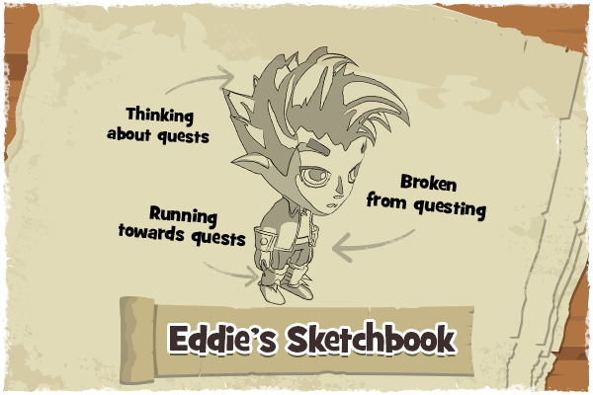
Case Study #3
Quests & Achievements
Progress tied to most actions
Avoid scripting
Data driven
Notes:
This is where DU and pattern matching saved me days and possibly even weeks in writing and maintaining the infrastructure that powers our quest and achievement system.

Slide 50
Caught a Gnome

Slide 51
Caught a Gnome
EXP
Item
Gold
Quest Progress

Slide 52
Caught a Gnome
EXP
Item
Gold
Level Up
Quest Progress
Quest Complete

Slide 53
Caught a Gnome
EXP
Item
Gold
Level Up
Quest Progress
Quest Complete
New Quest

Slide 54
Caught a Gnome
EXP
Item
Gold
Level Up
Quest Progress
Quest Complete
New Quest

Slide 55
Caught a Gnome
EXP
Item
Gold
Level Up
Quest Progress
Quest Complete
New Quest
Achievement Progress

Slide 56
Caught a Gnome
EXP
Item
Gold
Level Up
Quest Progress
Quest Complete
New Quest
Achievement Progress
Achievement Complete

Slide 57
Caught a Gnome
EXP
Item
Gold
Level Up
Quest Progress
Quest Complete
New Quest
Achievement Progress
Achievement Complete

Slide 58
Quests & Achievements
100+ actions available in the game
Most can be tied to quests/achievements
Many yield rewards
Triggered from different abstraction layers
Level controller
Trapping controller
...

Slide 59
Quests & Achievements
Non-functional requirements
Analytics tracking
3rd party reporting
...

Slide 60
Quests & Achievements
Message broker pattern
Something happened, it’s a FACT
Caught a Gnome
Received an item
Got some EXP
...

Slide 61
Queue
Caught Gnome
Trapping
Levelling
Quests
Achievements
Analytics
Partner Reporting

Slide 62
Queue
Caught Gnome
Trapping
Process
Levelling
Ignore
Quests
Process
Achievements
Process
Analytics
Process
Partner Reporting
Ignore

Slide 63
Queue
Caught Gnome
Trapping
EXP
Item
Levelling
Gold
Quests
Achievements
Analytics
Partner Reporting

Slide 64
Queue
Caught Gnome
Trapping
EXP
Item
Levelling
Gold
Quests
Achievements
Analytics
Partner Reporting

Slide 65
Queue
Caught Gnome
Trapping
Ignore
EXP
Item
Levelling
Process
Gold
Quests
Ignore
Achievements
Ignore
Analytics
Process
Partner Reporting
Ignore

Slide 66
Queue
Caught Gnome
Trapping
EXP
Item
Levelling
Gold
Level Up
Quests
Achievements
Analytics
Partner Reporting

Slide 67
Queue
Caught Gnome
Trapping
EXP
Item
Levelling
Gold
Level Up
Quests
Achievements
Analytics
Partner Reporting

Slide 68
Message Broker Pattern
Simple
Flexible
Extensible
Requires many types of facts!

Slide 69
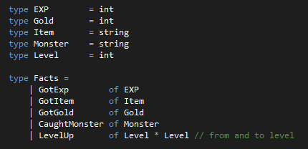
OK for small number of DU cases

Slide 70
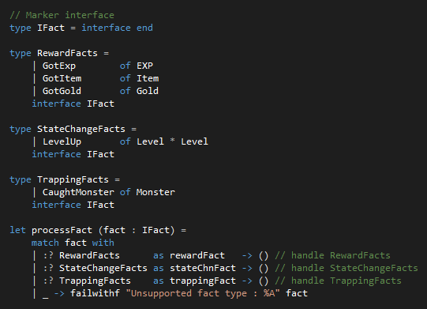

Slide 71
Why F#?
Time to Market
Efficiency
Correctness
Complexity

Slide 72
Why F#?
Discriminated Unions
Saved days/weeks in writing and maintaining a very large class hierarchy
Pattern Matching
Clear and concise way to handle all branch conditions

Slide 73
Case Study #4
DynamoDB.SQL*
SQL-like external DSL for working with Amazon DynamoDB
Built on top of FParsec
* http://theburningmonk.github.io/DynamoDb.SQL
Notes:
Mention other approaches such as using ActivePatterns with pattern matching, FsLex and FsYacc (lexer and parser generation tools), etc.

Slide 74
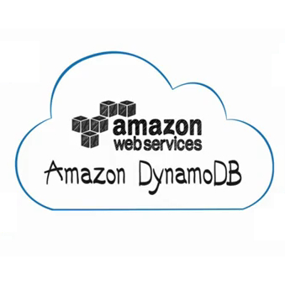
Amazon DynamoDB
Fully managed NoSQL database
Provisioned throughput
Potentially infinitely scalable
SSD-backed
Fast, predictable performance
Data replicated across data centres
Notes:
* Strong consistency, atomic counters

Slide 75
Amazon DynamoDB
Semi-schema
Hash and Range key
Local Secondary Index
Supports both strong or eventual consistency
Supports ‘query’ and ‘scan’ operations
Supports parallel scans

Slide 76
Amazon DynamoDB
API is cumbersome to use
Non-trivial queries are hard to express
.Net SDK doesn’t make it any easier...
Need an easier way to query for data

Slide 77
DynamoDB.SQL
Query with hash key only
SELECT Ticker, TimeStamp, Value FROM Prices
WHERE Ticker = “MSFT”
SELECT * FROM Prices WHERE Ticker = “MST”
Query with hash and range key
SELECT * FROM Prices
WHERE Ticker = “MSFT”
AND TimeStamp BEGINS WITH “2013-10”

Slide 78
DynamoDB.SQL
Ordering and Limiting number of results
SELECT * FROM Prices WHERE Ticker = “MSFT”
ORDER ASC
LIMIT 100
Using eventual consistency and throttling
SELECT * FROM Prices WHERE Ticker = “MSFT”
WITH (NoConsistentRead, PageSize(10))

Slide 79
DynamoDB.SQL
Counting without returning data
COUNT * FROM Prices WHERE Ticker = “MSFT”
COUNT * FROM Prices
WHERE Ticker = “MSFT”
AND TimeStamp BEGINS WITH “2013-10”

Slide 80
DynamoDB.SQL

Slide 81
Why F#?
Time to Market
Efficiency
Correctness
Complexity

Slide 82
Why F#?
Record and Discriminated Unions
Lightweight syntax for creating types and hierarchies
Illegal states cannot be represented
Immutable by default
Pattern matching
Clear and concise way to handle all branch conditions

Slide 83
Why F#?
Active Patterns
Extends the power of pattern matching
Composable
Async Workflows
Non-blocking IO
Convert synchronous code into asynchronous code with minimal code changes
Similar to C# 5’s async-await feature, but available in F# since 2007!

Slide 84
Thank You!

Slide 85
JackpotJoy Slots http://apps.facebook.com/jackpotjoyslots Bingo Lane http://apps.facebook.com/bingolane Here Be Monsters http://apps.facebook.com/herebemonsters Building a MMORPG http://bit.ly/1hjqoL8 http://slidesha.re/18MD4XY Google I/O 2013 – Here Be BigQuery http://bit.ly/1fHjbce

